Slide 1
Installation of POWER BI
PRESENTED BY – REMYA R S

Slide 2
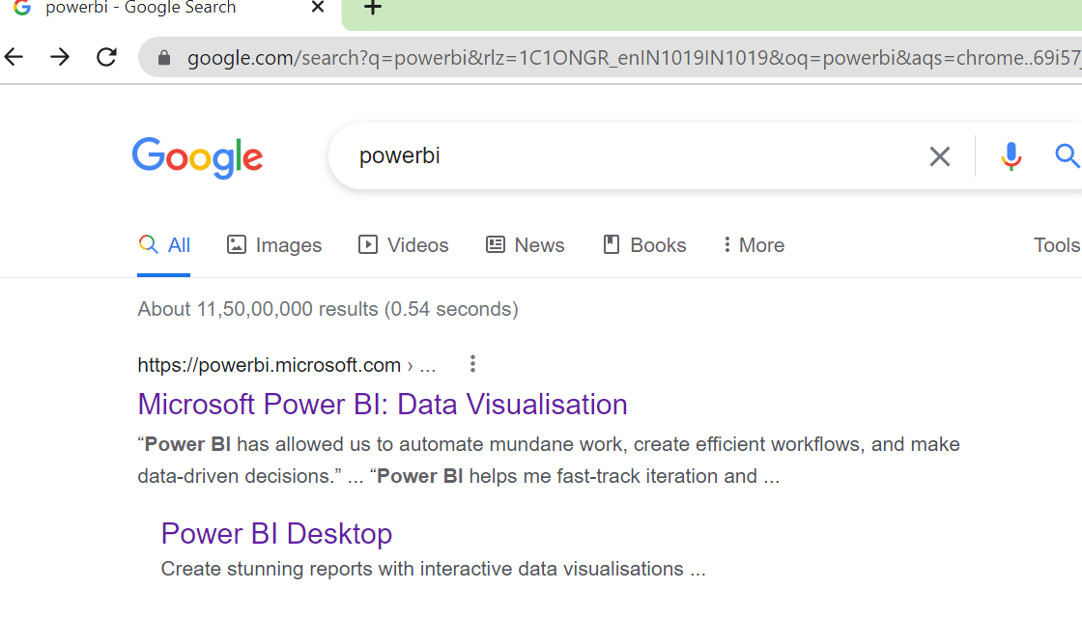
Install power bi

Slide 3

Install power bi

Slide 4
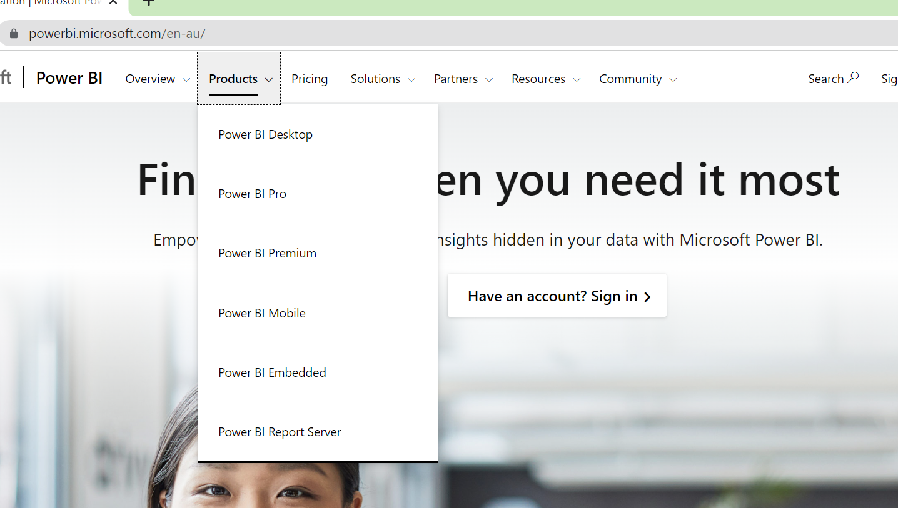
Install power bi

Slide 5
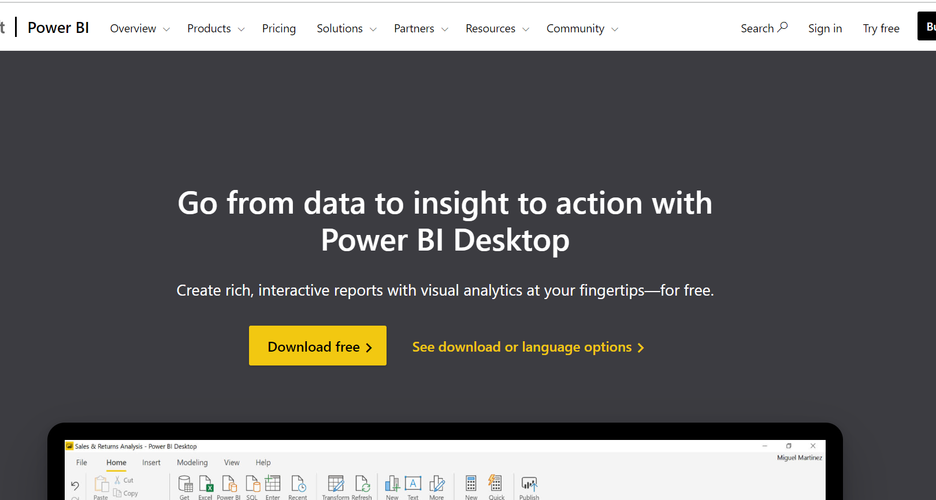
Install power bi

Slide 6
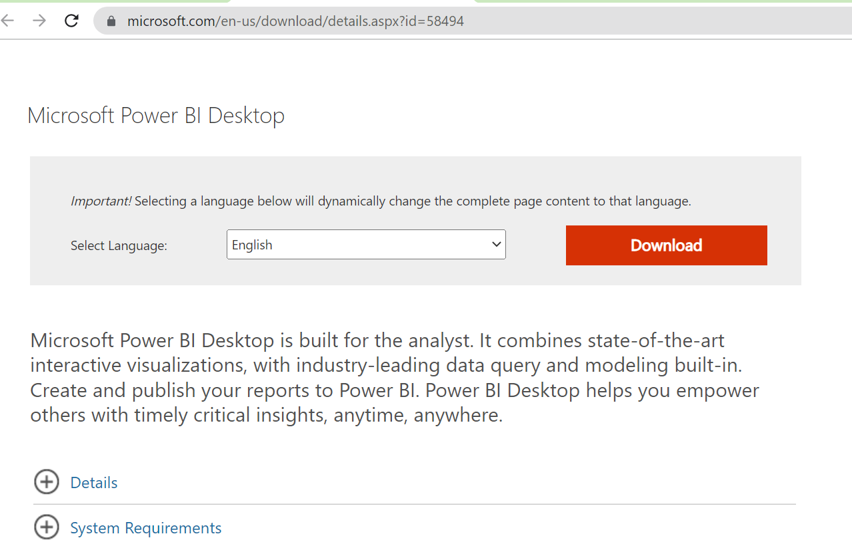
Install power bi
Choose the language you want
Then click on Download

Slide 7
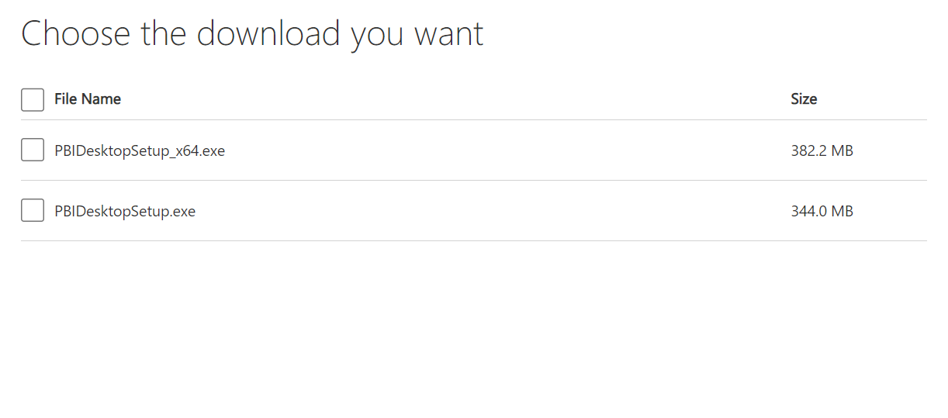
Install power bi
Choose this check box if your system is of 64 bit
Choose this check box if your system is of 32 bit

Slide 8
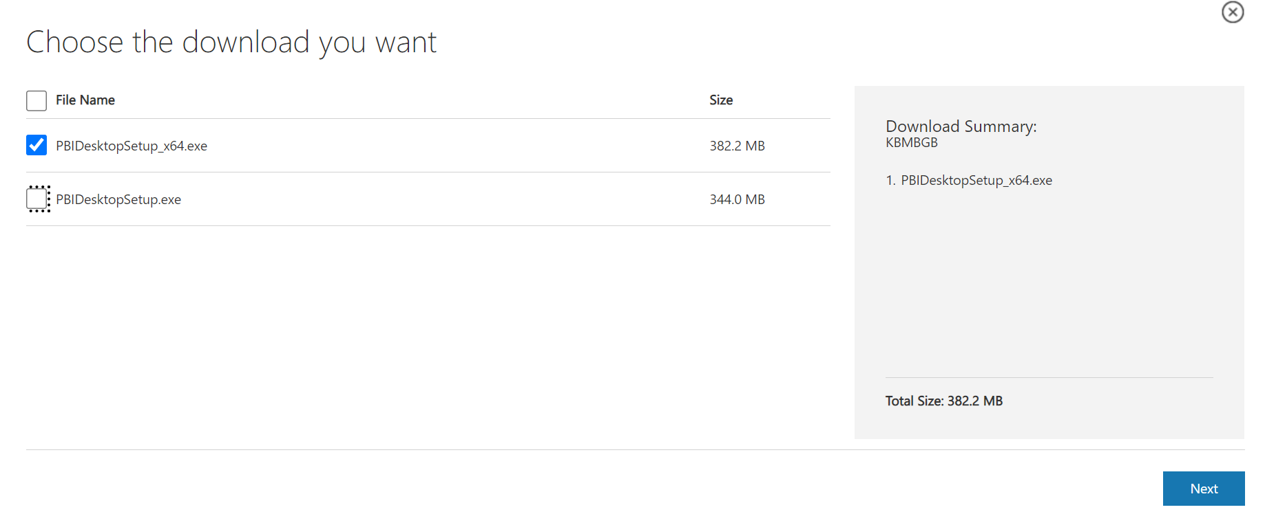
Install power bi

Slide 9
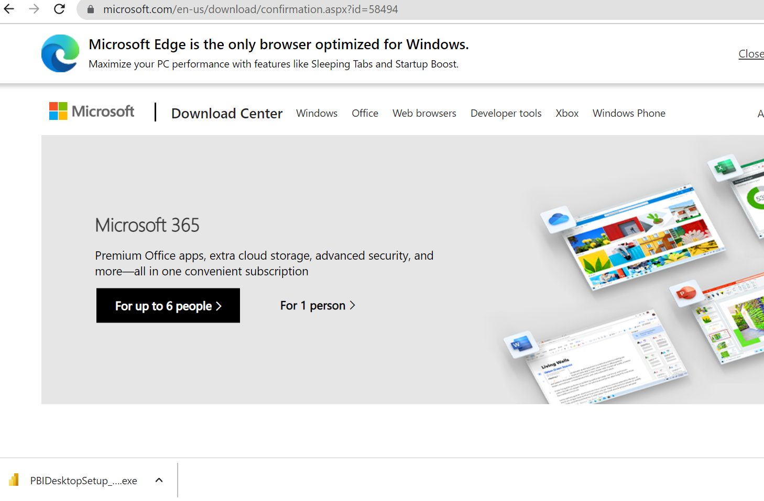
Install power bi
Double click on setup file

Slide 10
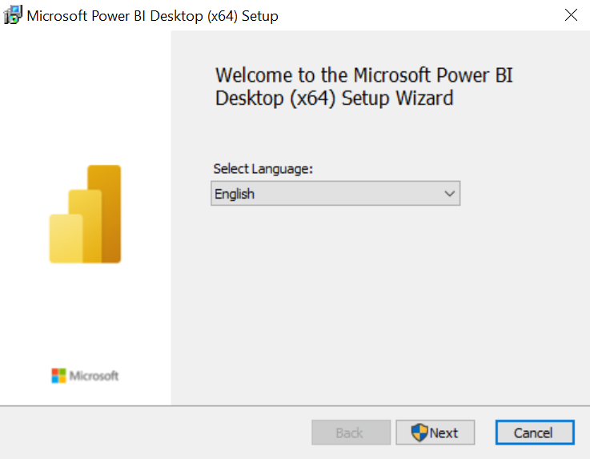
Install power bi

Slide 11
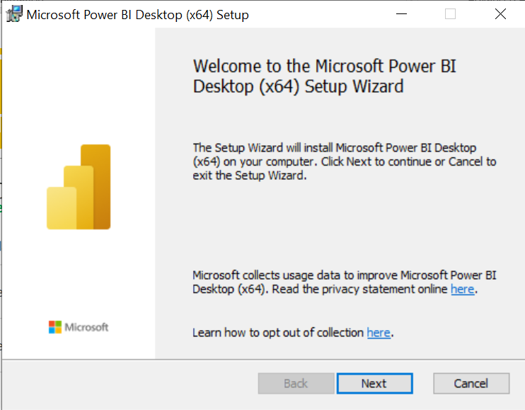
Install power bi

Slide 12
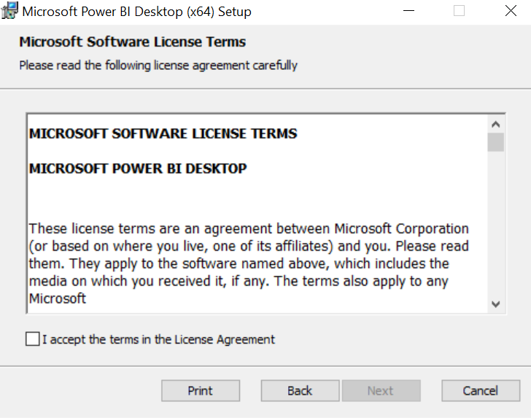
Install power bi

Slide 13
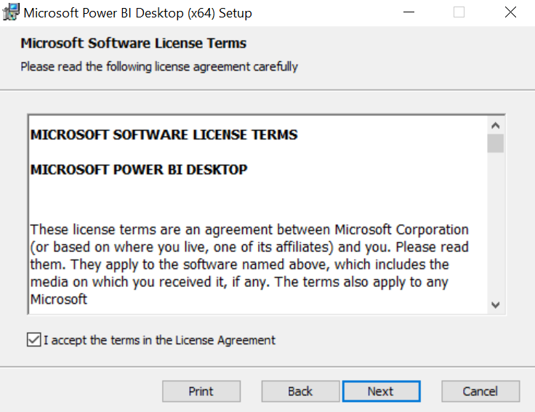
Install power bi

Slide 14
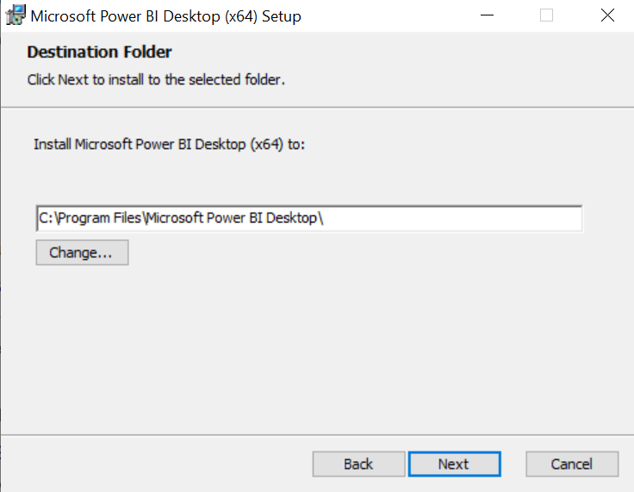
Install power bi

Slide 15
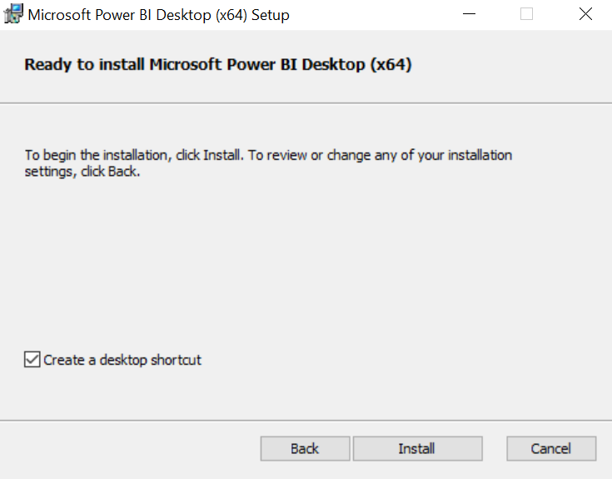
Install power bi

Slide 16
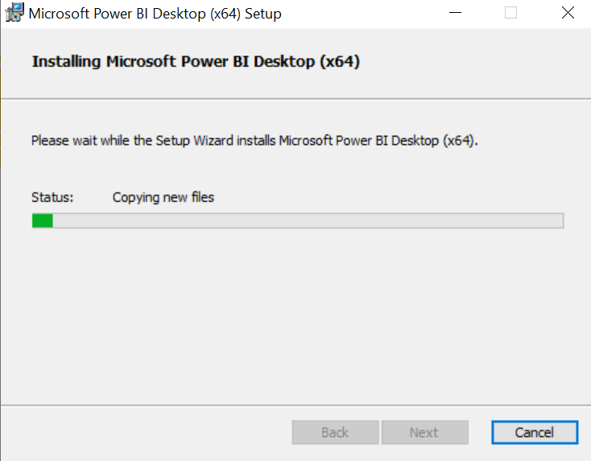
Install power bi

Slide 17
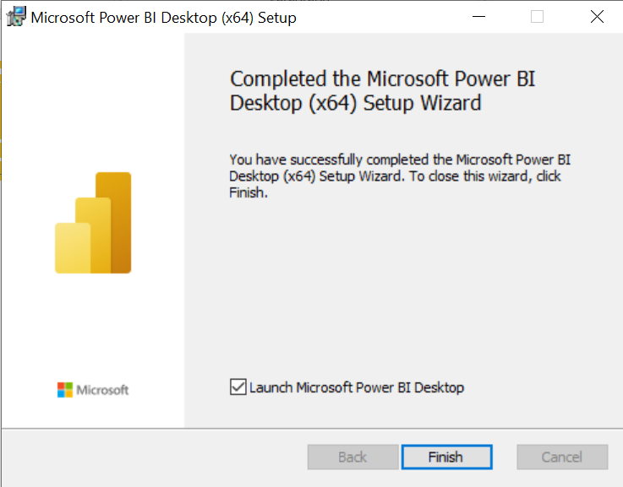
Install power bi

Slide 18

Install power bi

Slide 19
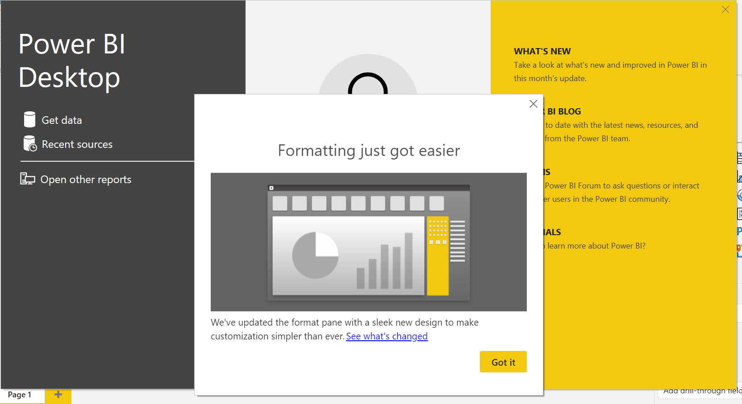
Install power bi

Slide 20
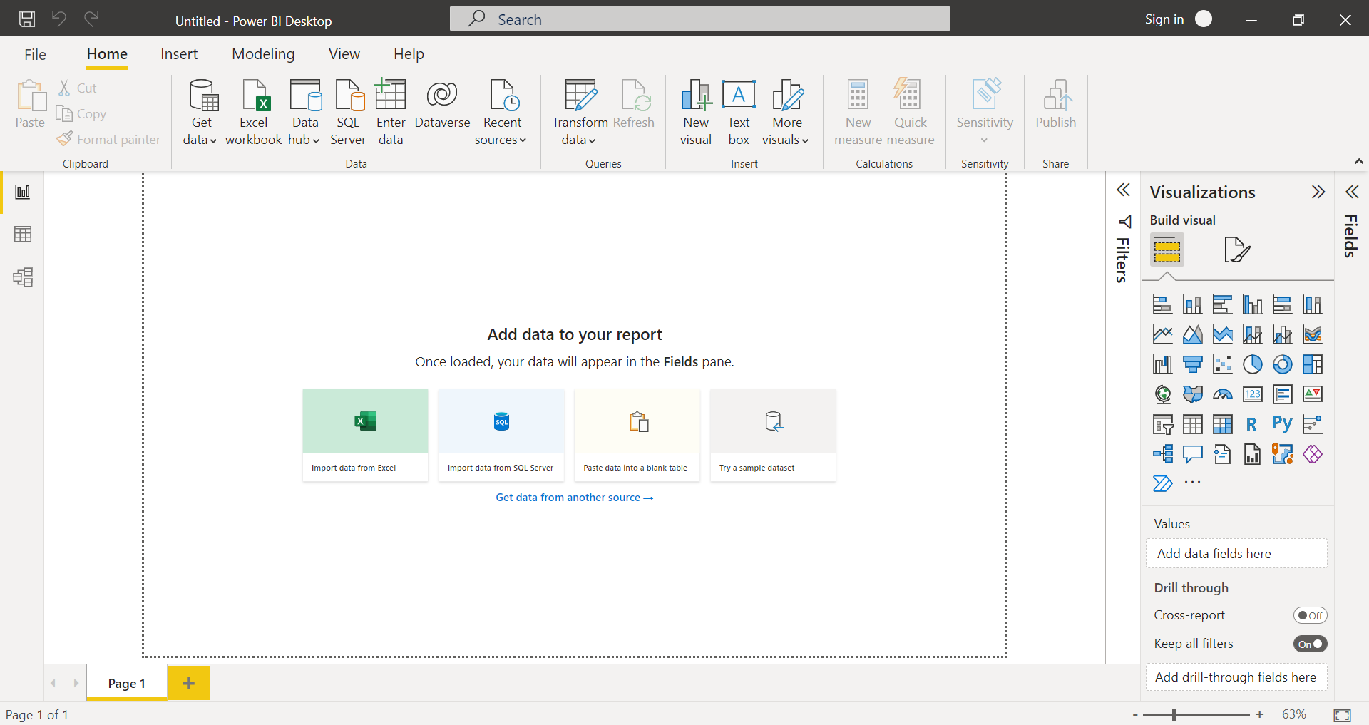
CHECK power bi
If you do not have this option then you are in older version of Power BI

Slide 21
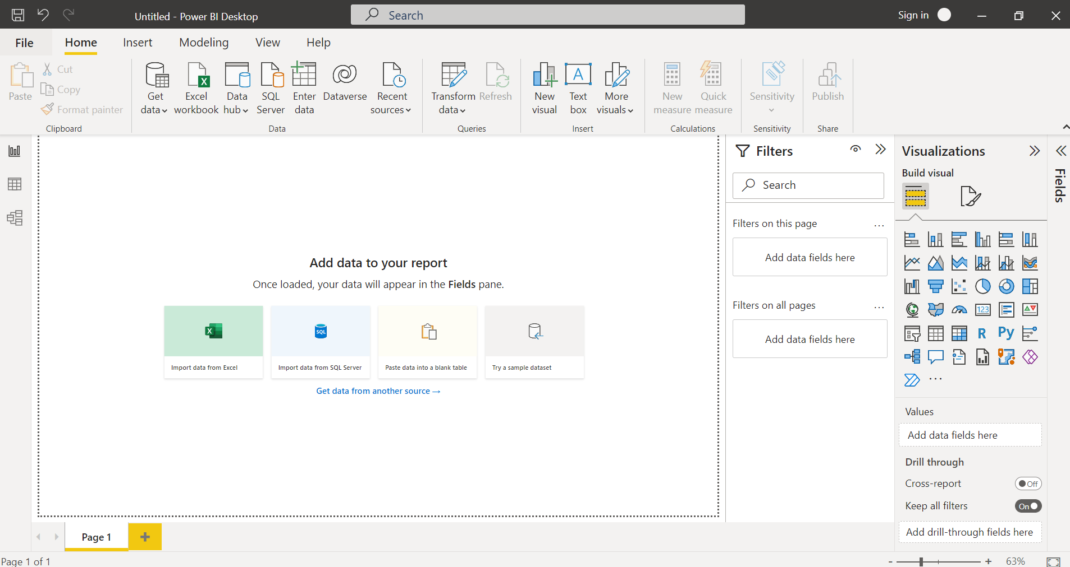
check power bi
If you do not have this window pane then you are in older version of Power BI

Slide 22
Upgrade power bi

Slide 23
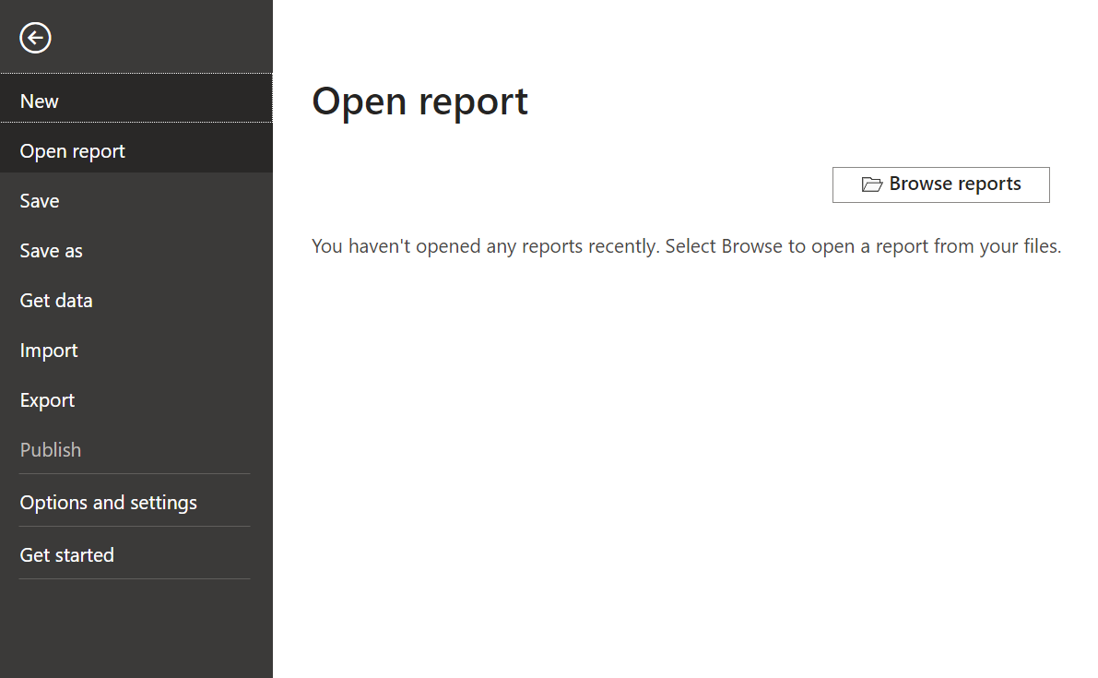
Upgrade power bi

Slide 24
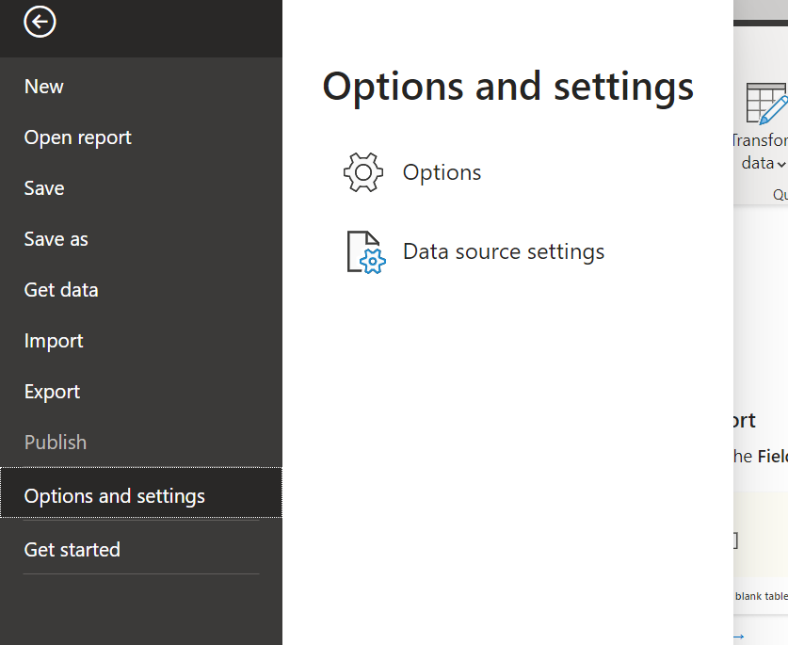
Upgrade power bi

Slide 25
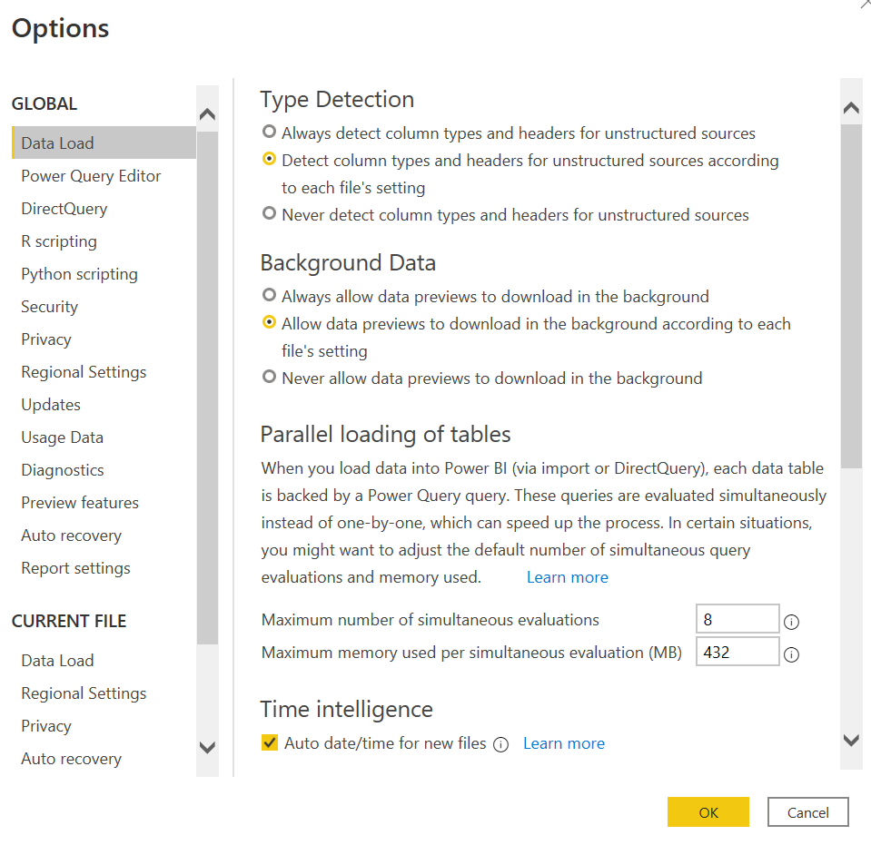
Upgrade power bi

Slide 26
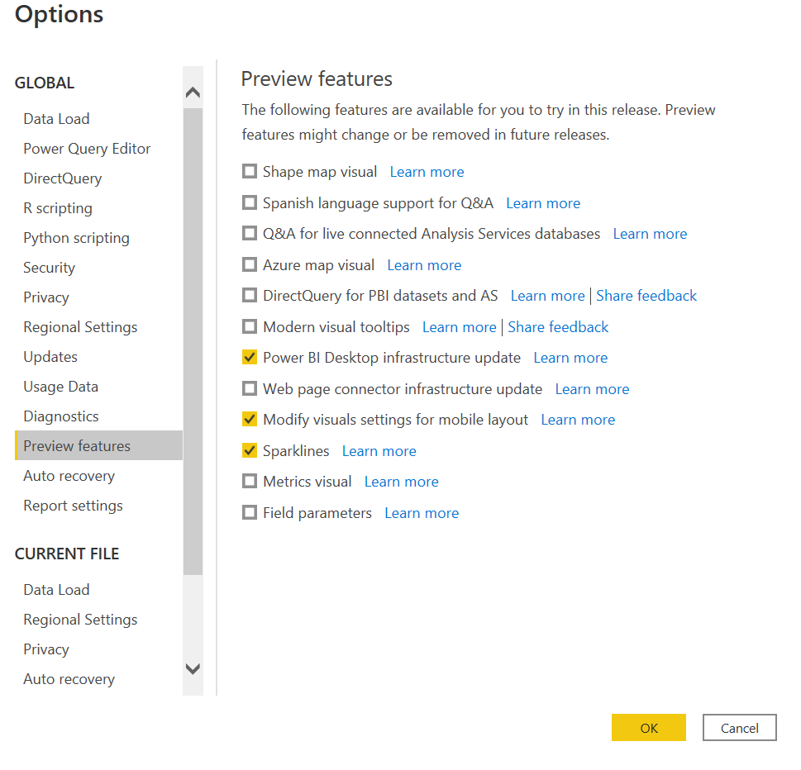
Upgrade power bi
Now click check boxes whichever you want

Slide 27
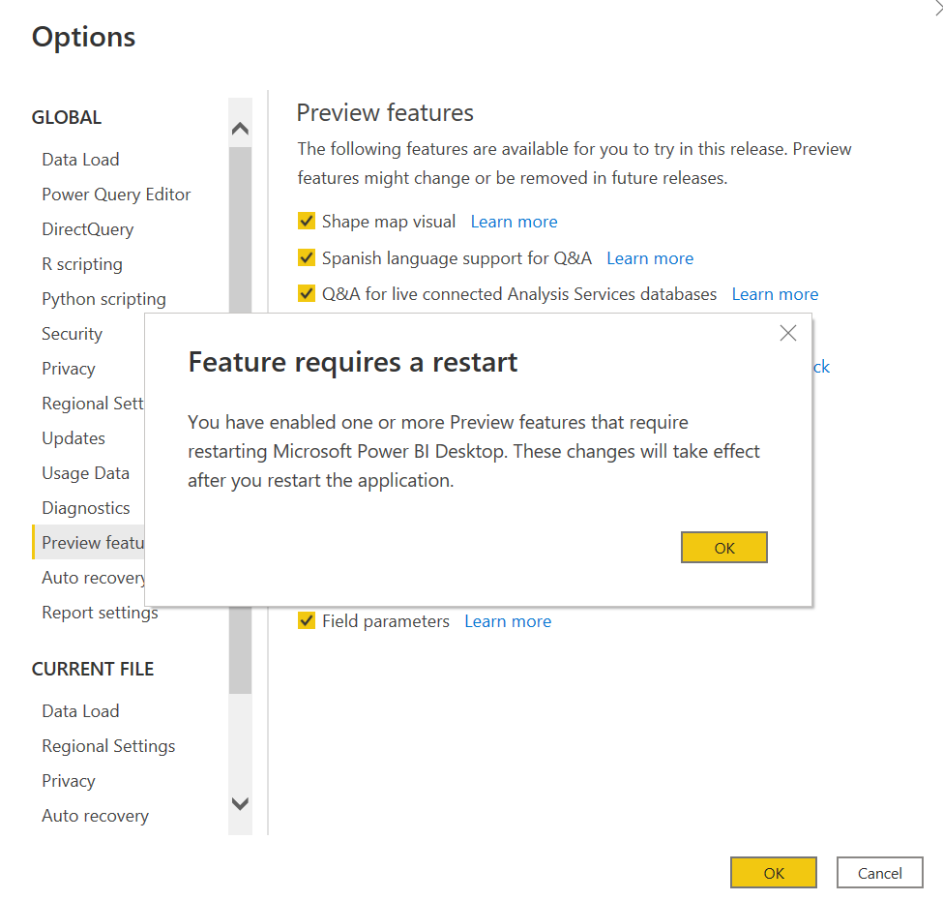
Upgrade power bi

Slide 28
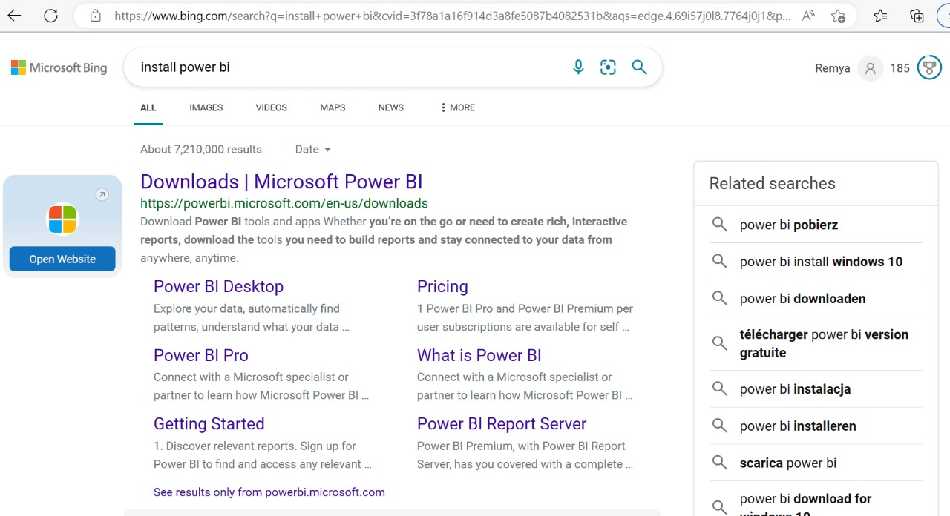
install power bi

Slide 29
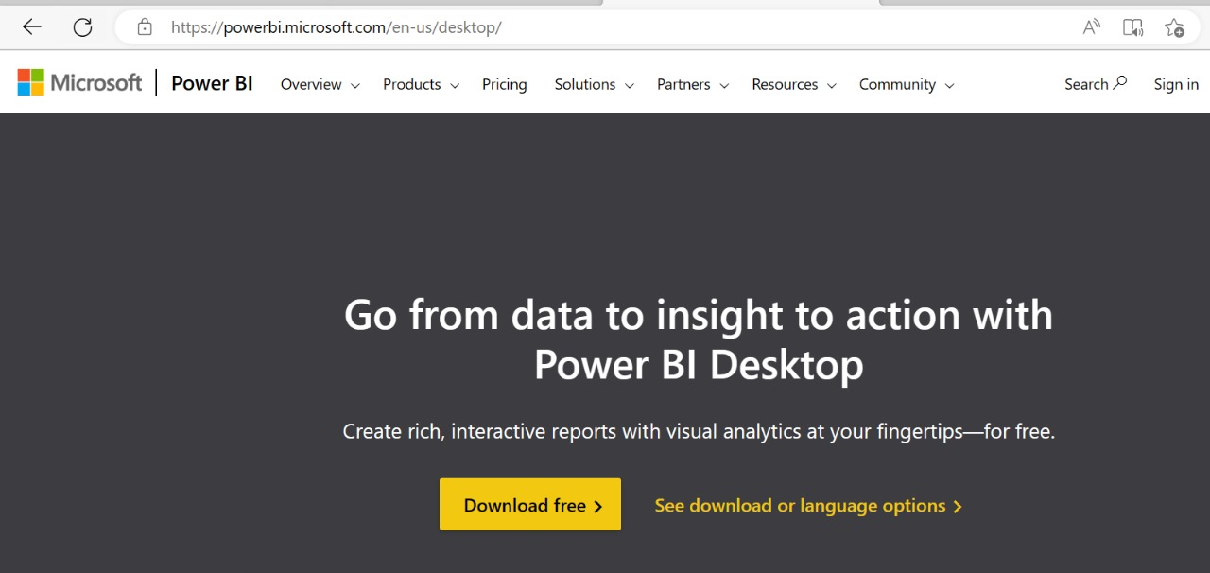
install power bi

Slide 30
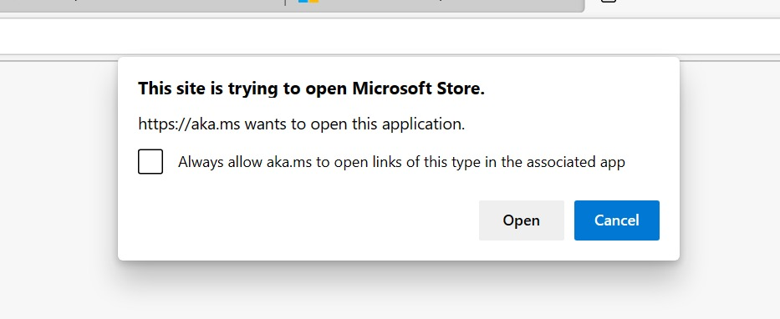
install power bi

Slide 31
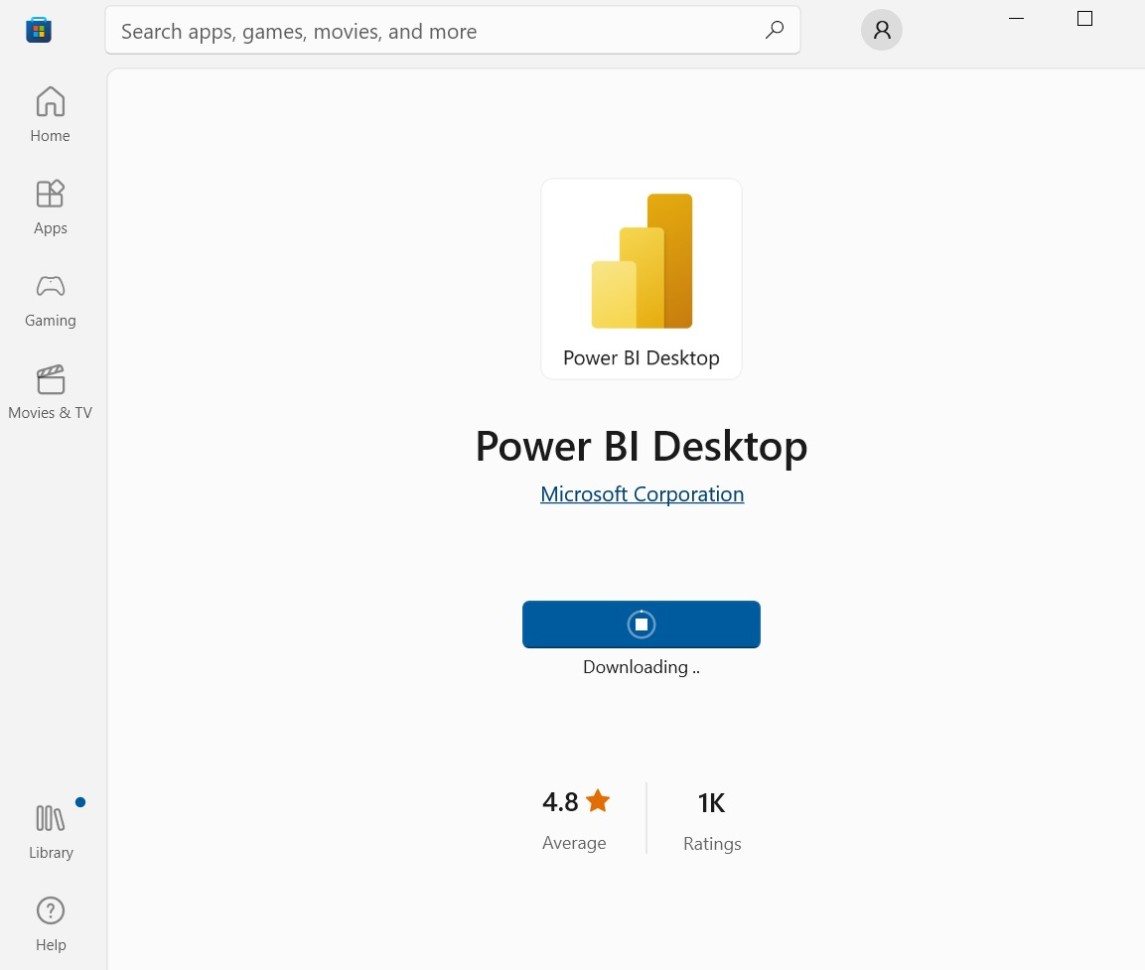
install power bi

Slide 32
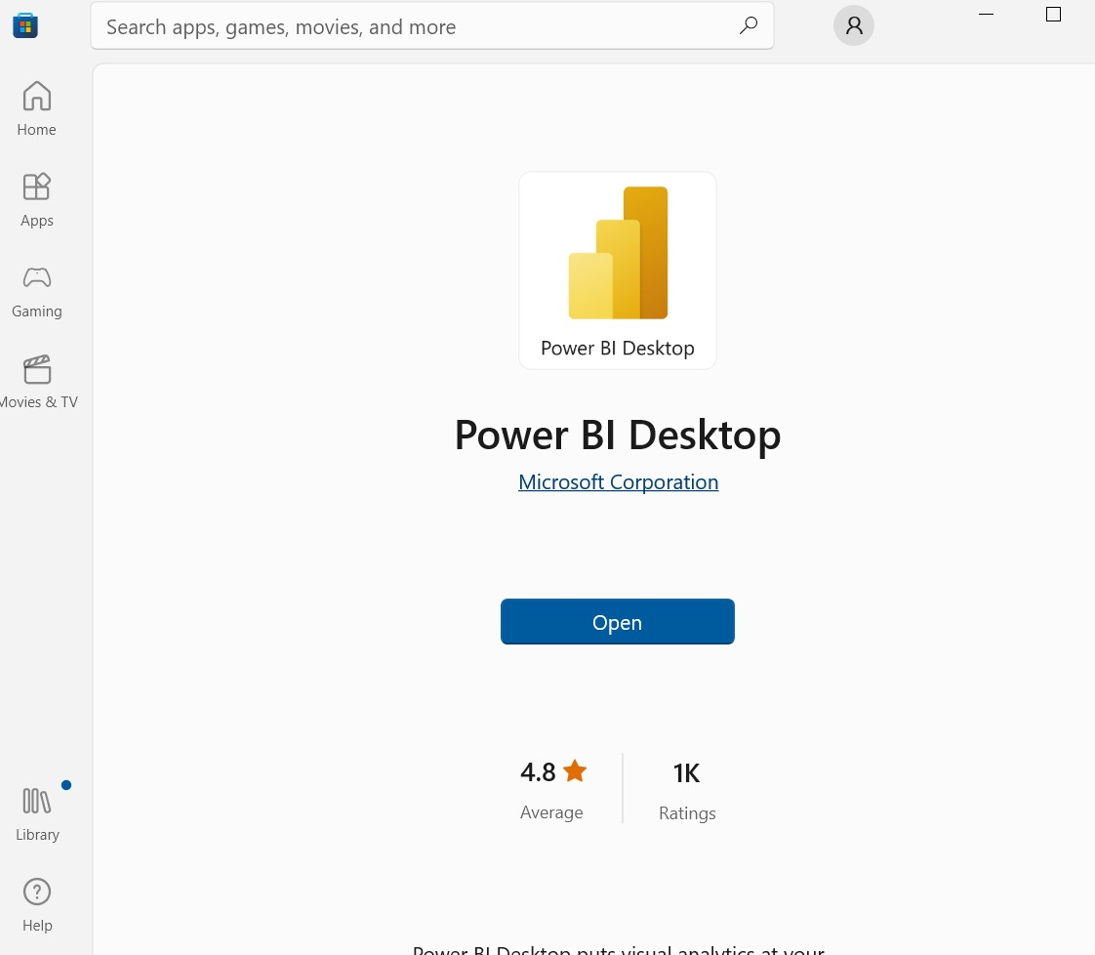
install power bi

Slide 33
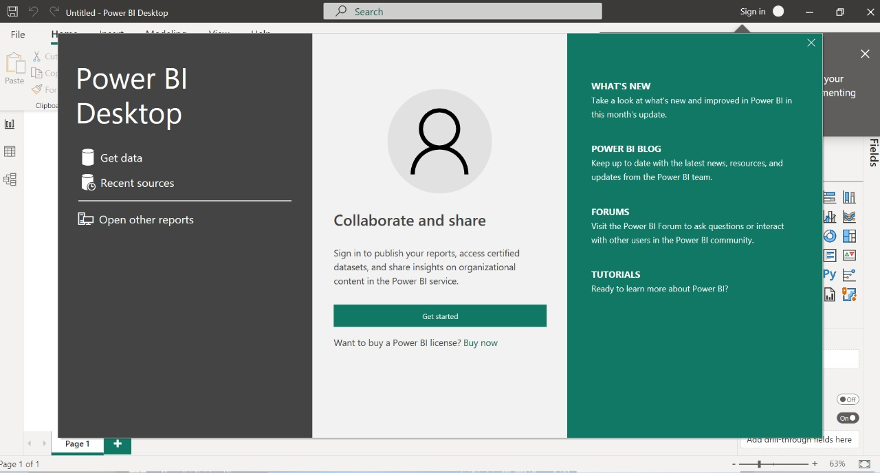
install power bi

Slide 34
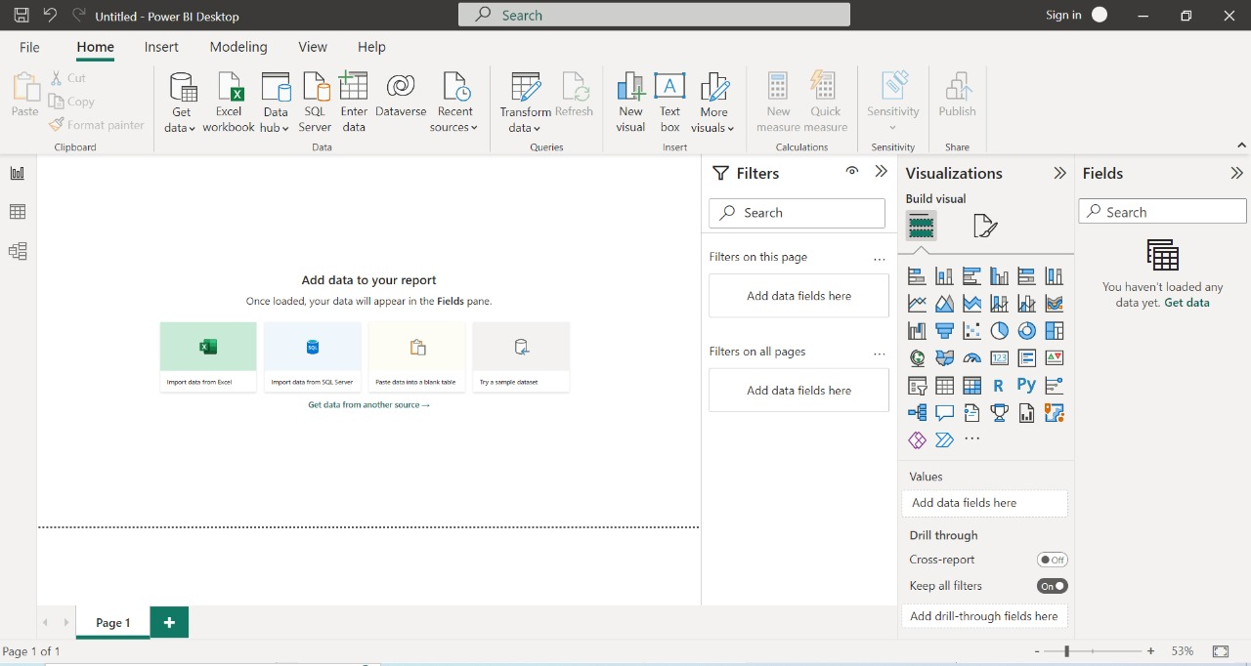
Power Bi desktop
Menu Bar
Ribbon
Views
Filter
Fields
Visualization
Pages

